Slide 1
Employee Data Analysis using Excel
STUDENT NAME: NANDHINI. S
REGISTER NO: 312220259
DEPARTMENT: Commerce
COLLEGE: Jeppiaar college of Arts and science

Slide 2
Employee Performance Analysis using Excel:
Analyzing performance data in Excel using array formula and dynamic range name methods.
The recording and analysis of performance data is the quintessential spreadsheet application.
In every company, probably in every department, performance data is collected in Excel.

Slide 3

AGENDA
Problem Statement
Project Overview
End Users
Our Solution and Proposition
Dataset Description
Modelling Approach
Results and Discussion
Conclusion
3/21/2024 Annual Review

Slide 4

PROBLEM STATEMENT
The solution should be built using Microsoft Excel and utilize features such as pivot tables, charts, and conditional formatting.
The tool should be able to handle large datasets and perform calculations efficiently.

Slide 5

PROJECT OVERVIEW
Collect and integrate employee performance data from various sources
Design a user-friendly dashboard for visualization and analysis
Develop automated calculations and metrics for performance evaluation
Implement data validation and error handling for accuracy and consistency
Create a user guide for easy adoption and usage.

Slide 6

Who are the end user of an employee
HR Managers
Department Manager
Team Leads
Employees
Senior Leadership
Talent Management Specialists
Business Analysts

Slide 7
OUR SOLUTION AND ITS VALUE PROPOSITION
Our Employee Performance Analysis solution is a comprehensive Excel-based tool designed to streamline and enhance employee performance evaluation:-
Value Proposition:
1. Streamline performance tracking
2. Gain actionable insights
3. Make data-driven decisions
4. Enhance employee engagement

Slide 8
Dataset Description
Description:
This dataset contains employees performance metrics and attributes, used to evaluate and analyse individual and team performance:-
- Data sources
- Data Fields
- Data frequency

Slide 9
THE "WOW" IN OUR SOLUTION
Automated Data Integration
Real-time Performance Dashboards
AI-powered Insights
Customizable Performance Templates
Collaborative Feedback Tools
Employee Performance Scorecards
Predictive Analytic
Integration with Existing HR Systems
3/21/2024 Annual Review
‹#›

Slide 10
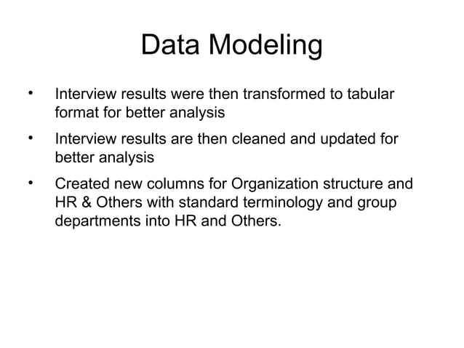
MODELLING
‹#›

Slide 11
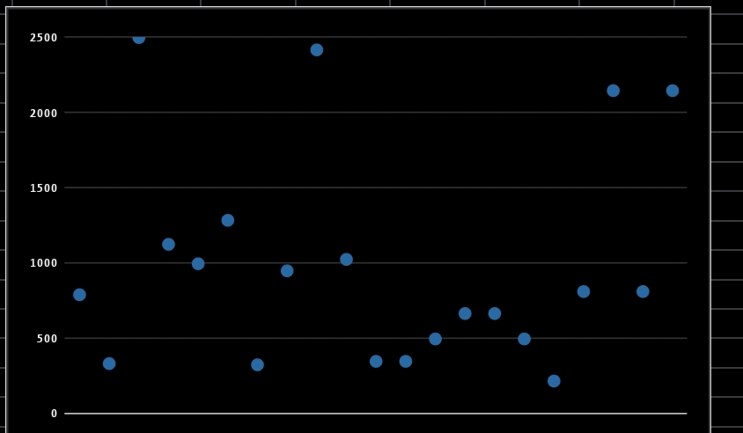
‹#›

Slide 12
conclusion
"By leveraging Excel to analyze employee performance, organizations can unlock powerful insights, drive business success, and foster a culture of continuous improvement. With automated data collection, visualization, and analysis, HR professionals and managers can:
- Make data-driven decisions about talent management and development
- Identify top performers and areas for recognition
- Address weaknesses and opportunities for growth
- Inform training and development initiatives
- Reduce turnover and improve employee engagement

